Slide 1

Capstone - D96D97D98 Project 1 Youtube
Saravanan Varadharajan
Ds_youtube data harvesting and warehousing using SQL, mongodb and streamlit

Slide 2
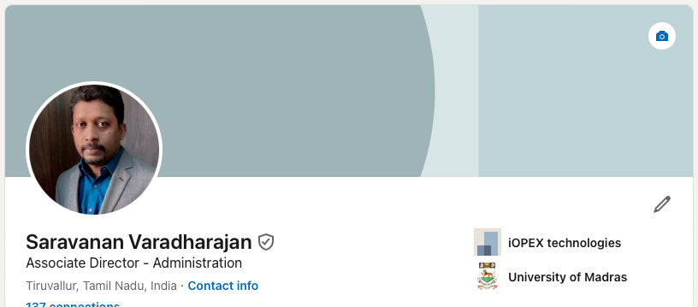

Slide 3



Project Title | YouTube Data Harvesting and Warehousing using SQL, MongoDB and Streamlit
Skills take away From This Project | Python scripting, Data Collection, MongoDB, Streamlit, API integration, Data Management using MongoDB (Atlas) and SQL
Domain | Social Media
Problem Statement:
The problem statement is to create a Streamlit application that allows users to access and analyze data from multiple YouTube channels.
The application should have the following features:
Ability to input a YouTube channel ID and retrieve all the relevant data (Channel name, subscribers, total video count, playlist ID, video ID, likes, dislikes, comments of each video) using Google API.
Option to store the data in a MongoDB database as a data lake.
Ability to collect data for up to 10 different YouTube channels and store them in the data lake by clicking a button.
Option to select a channel name and migrate its data from the data lake to a SQL database as tables
Ability to search and retrieve data from the SQL database using different search options, including joining tables to get channel details.

Slide 4
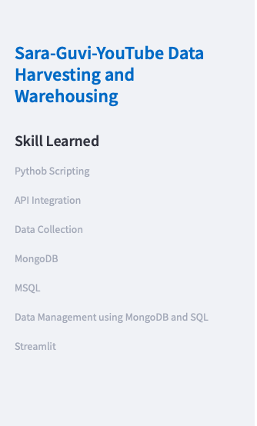
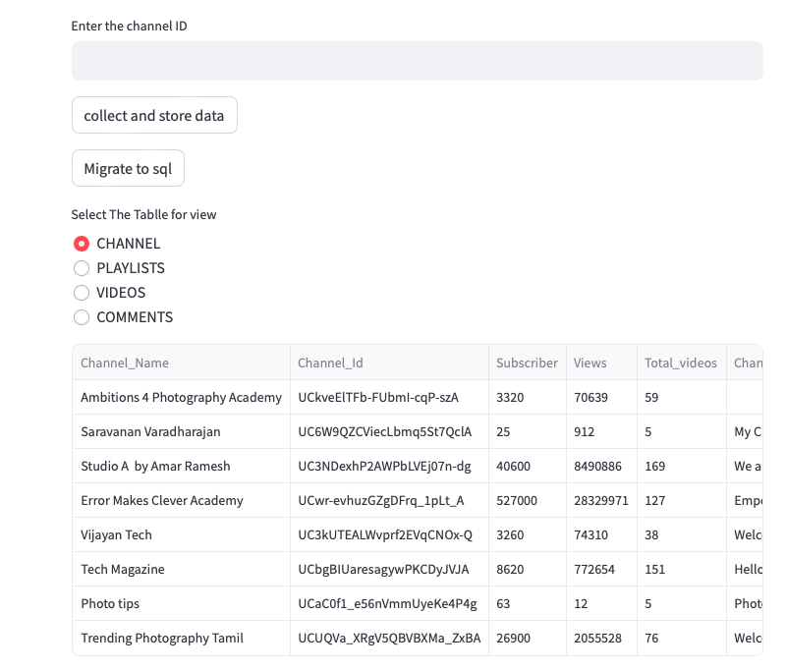
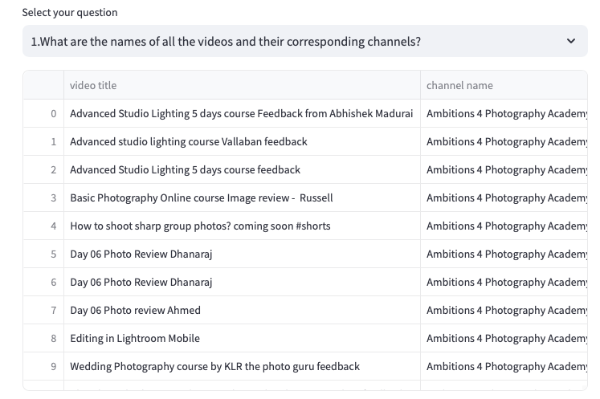
Streamlit Pages:

